Slide 1
Thanks a lot for your participation!!! ☺
Here is the last question for you.
Did you dee the group motion of the disks?
Please proceed to the next slides to see the examples ;)
(In main_3disk_nonret and main_3disk_ret conditions)

Slide 2
Group Motion: Three disks are moving left-and-right in concert

Slide 3
Element Motion: two disks in the middle are flickering and the third disk is jumping from left to right

Slide 4
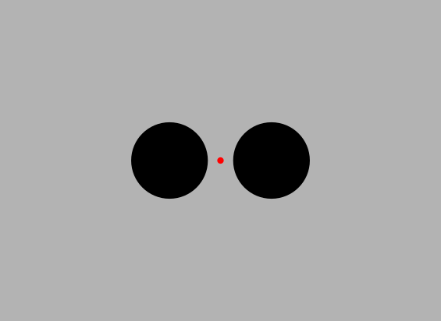
Which disk-motion did you perceive (1-5 scale)?
1
2
3
4
5
Element motion
Group motion
Jumping left-right
Moving left-right altogether

